Slide 1
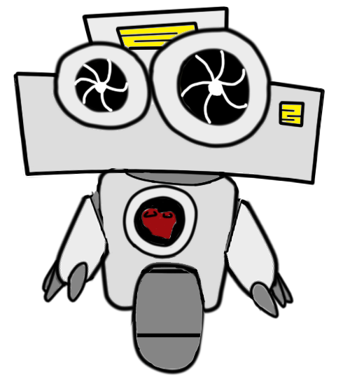
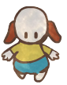
Group Project
Level 4/5 Group 9
Bailey Keeble
Blake Hewitt
Thomas Gibbs
Ogheneochuko Ideh
Notes:
Welcome to the final group presentation of Group 9 for the group project module.
I am :
We are here to talk about our game and our story.

Slide 2
Business First
4 authors have pushed 113 commits to master and 113 commits to all branches
Notes:
Before we begin, we must get all the boring stuff out of the way.

Slide 3
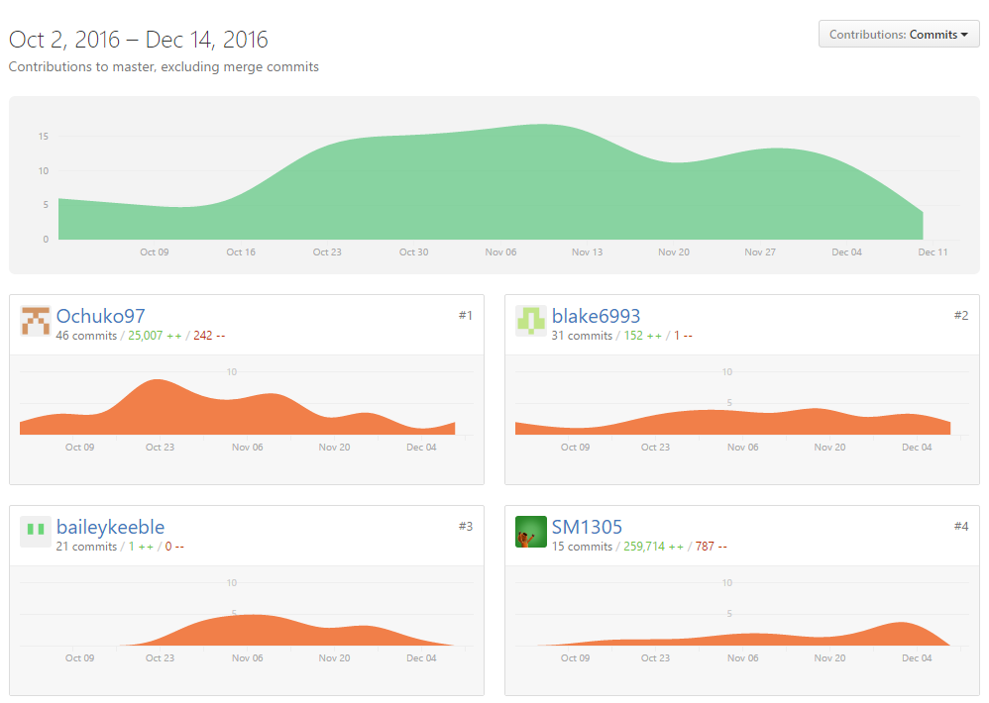
Git Contributions
Notes:
This showcases the amounts of commits made by each group member to the master branch from the begin of the project till the end.
This spike shows us that group members were most active with the project around early to mid November.
We can attribute this decrease in productivity to a simultaneous decrease in moral from members following feedback received when failed to meet the brief properly.

Slide 4
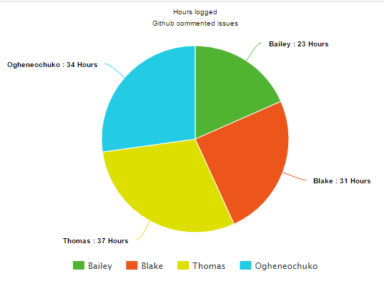
Logged hours
Bailey:
23 hr 10 mins
Blake:
31 hours 30 mins
Thomas:
37 hours
Ogheneochuko:
34 hours 15 mins
Notes:
Let us begin hours loggesd during the active sprint of this project.
No effective way of storing data from logged hours was found in Github.
We relied on members commenting time logged on each task by commenting on Github issues.
This allowed leaders to source through issue cards and compile hours logged by team members.

Slide 5
The Brief
Obscure Sorrows

Slide 6


Emotions
Rückkehrunruhe
Occhiolism
Figure 1
Figure 2
Notes:
The brief stated that we pick two emotions out of the list of obscure emotions and formulate these emotions into gameplay experiences.
These emotions are:
Ruckkehrunruhe : “ the feeling of returning home after an immersive trip only to find it fading rapidly from your awareness”
Occhilolism : “awareness of the smallness of your perspective”
We played with ideas of having our player returning to war as a veteran and having their memories of the war fading away leading then MC TO LOOSE THEIR GRIP ON REALITY.
As well has having a fog of war mechanic overwhelming the player and giving the false perspective of a small and constraphobic perspective during gameplay.

Slide 7
Logline
Mans best friend must now brave this new adventure as he struggles to avoid vicious feline ghouls whilst collecting the remnants of his memories.
Notes:
The logline for our game goes as follows:
Mans best friend must now brave this new adventure as he struggles to avoid vicious feline ghouls whilst collecting the remnants of his memories.

Slide 8
Game Classification
Title: | Dogdays
Platform: | PC, Windows.exe
Genre: | Avoidance, Collection game
Audience: | 12 – 16 males and females
Notes:
These are the final classification for our product.
Title : Dogdays
Platform: The game will be playable on PCs as a Windows executable file
Genre: Our finished game channels both instances of avoidance and collecting games.
Audience: Over the course of the product our audience has changed.
The initial audience of or game was to be males aged between 16-24, as our game dealt with more mature tones and a shooting mechanic.
According to the PEGI system games which feature violence such as shooting as a descriptor should be uphold an age rating of 18.

Slide 9
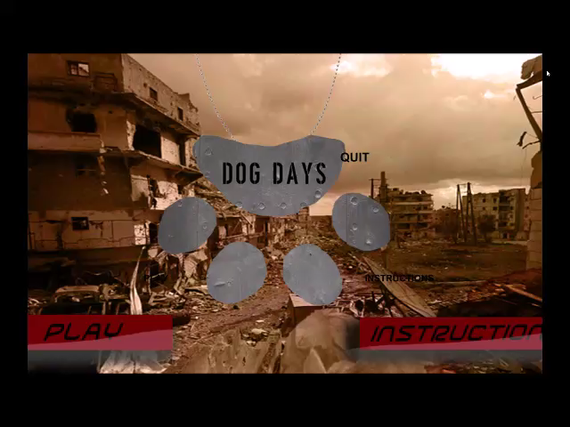
Video Walkthrough

Slide 10
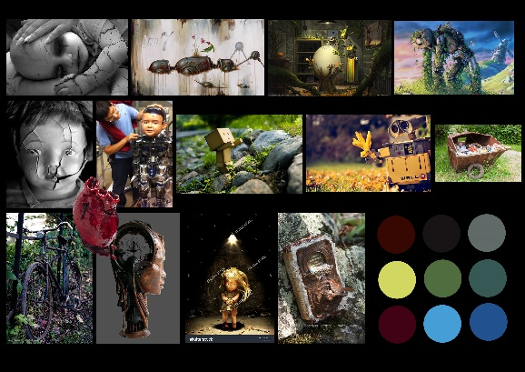
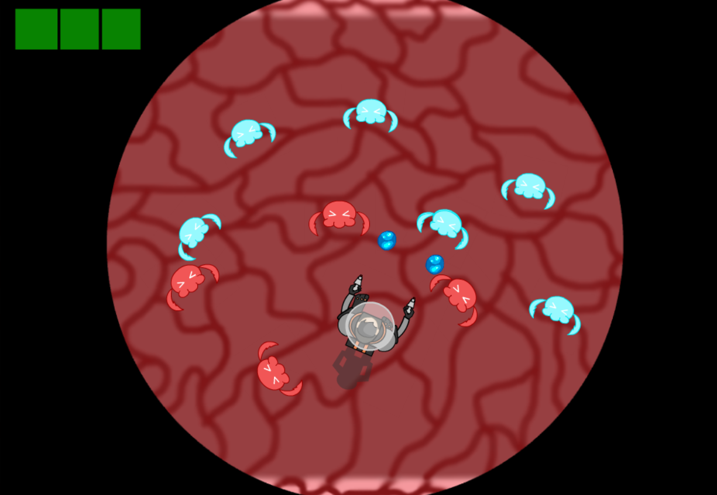
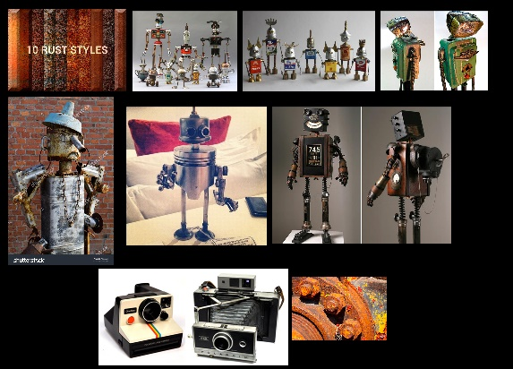
How we got here
We started with the initial pitch for a top – down shooter.
Notes:
When we began this project, we began with the initial pitch of a generic top down shooter.
We were challenged by stakeholders and overtime our game became an avoidance and collecting game.
One major critic being our choice of creating a shooter game. This was considered first level consciousness by stakeholders.
As designers we understood that we needed to push further with our designs.
Through this we had iterated the mechanics we already had in our game (avoiding, collecting) and got loose of the generic shooting mechanic.
Through our iterations we had established innovates ways of deafating the villains and conflicyt of the group through those simple mechanics.

Slide 11
Collect
Traverse level (easier)
Destroy Enemies
- Core Game Loop -
Notes:
These are all variables in which we picked out as being beneficial to the players.
Each action in this loop creates a positive feedback loop.
Collection: When players collect memory shard they either gain more HP or send their HP gage into ‘Overcharge’ depending on the state of their health.
The Overcharge will in turn destroy all enemies currently on the field.
Destroying enemies: By destroying enemies the playing field of the game becomes more balanced as enemies could be quite overbearing when they swam, as seen in the walkthrough video earlier.
Traversing level: By destroying the enemies in the field the level becomes easier to traverse as tight spaces which where once occupied by enemies could be free-d up and in turn allowing openings to collect harder to reach memory shards.
These mevhanics form our core game loop. As long as they keep looping the player interst is sustained.

Slide 12
Achieving Fun
Hard Fun
Enemy ambushes creates frustration
Defeating level will create triumph and relief “Fiero”
Serious Fun
Main and side objectives.
Learning enemy tactics.
Easy Fun
Level Exploration
Varied enemies
Collection Score
Power Ups

Slide 13
Scope and End Goals

Slide 14
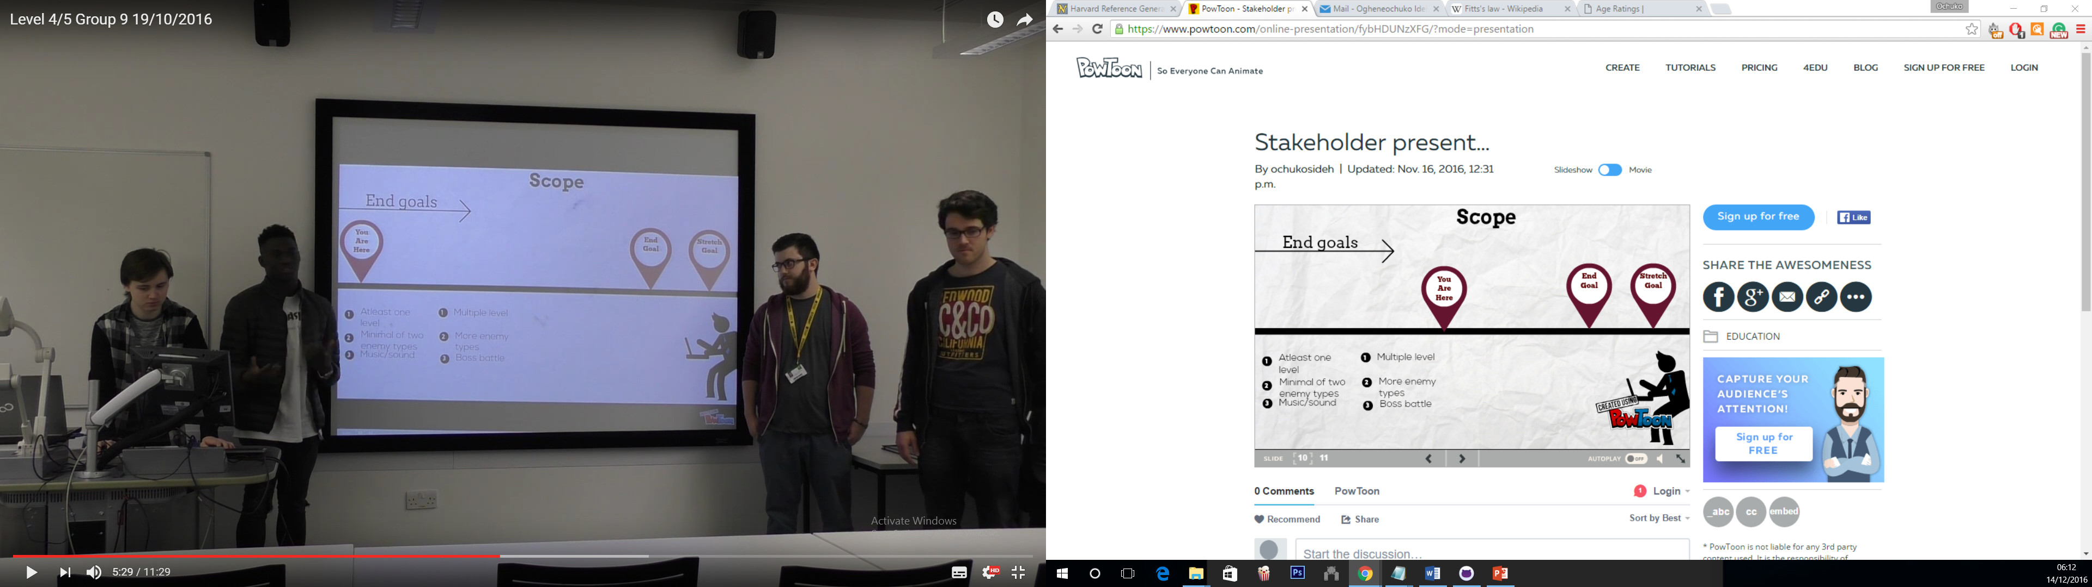
Figure 3
Notes:
Looking back at our initial pitch it is evident that we had managed to reach must of our end and stretch goals.
This includes:
Atleast one level
Minimal of two enemy types
Multiple levels
Uortunately there were some we could not reach:
Music/ sound
More enemy types
Boss battles.

Slide 15
Major Lessons Learned
and how it impacted the product
Notes:
What we have a team have learnt from this group project and how it has impacted our project and ultimately product.

Slide 16
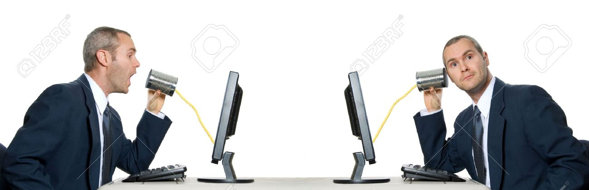
1) Effective comunication
Directly solve/avoid issues.
Further cemented understanding of task and project aims.
Figure 4
2) Do: Follow the brief.
Do not: Force the brief to follow you.
Time misspent justifying poor mechanics.
Made our game aesthetically cohesive.
Allowed us to graduate to professional designers as we understood that
3) Formal design tools: Game design is not just about designing a game, but rather designing a experience. This is achieved through formal design tools such a ; Photoshop, Flash, Unity.

Slide 17
Bibliography
Figure 1
Stephen Feller . (2015). Study shows that 'lost' memories can be recalled. Available: http://www.upi.com/Health_News/2015/05/29/Study-shows-that-lost-memories-can-be-recalled/2971432911414/. Last accessed 13/12/2016.
Figure 2
Mario Fraioli. (Nov. 5, 2010). Photo Gallery: The New York City Marathon Pre-Race Scene . Available: http://running.competitor.com/2010/11/photos/photos-from-friday-at-the-ing-new-york-city-marathon_16496. Last accessed 12/12/2016.
Figure 3
Elevate UCS. (2016). Level 4/5 Group 9 19/10/2016. Available: https://www.youtube.com/watch?v=0Mx1xqVhOJM. Last accessed 12/12/2016.
Figure 4
Yanik Chauvin. (2012). Stock Photo - 2 businessmen with telephone can internet communication. Available: http://www.123rf.com/photo_621440_2-businessmen-with-telephone-can-internet-communication.html. Last accessed 09/12/16.
Walkthrough music
Benjamin TISSOT. (2012). ROYALTY FREE MUSIC by BENSOUND. Available: http://www.bensound.com/. Last accessed 13/12/2016.

